Slide 1
LESSON 5.2
Intermolecular Forces

Slide 2
LESSON GOALS
I can deduce the types of intermolecular forces present in substances, based on their structure and chemical formula, and use these forces to explain their physical properties

Slide 3
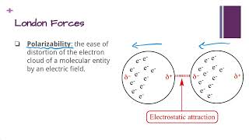
TASK 1: LEARN (MUST DO)
Individually or with a partner:
Watch the Intermolecular Forces Part 1 video
Complete the appropriate section of the guided note

Slide 4
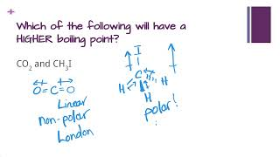
TASK 2: LEARN (MUST DO)
Individually or with a partner:
Watch the Intermolecular Forces Part 2 video
Complete the appropriate section of the guided note

Slide 5
NOTE!
You can quickly and easily determine the intermolecular forces present in a molecule if you know its polarity!
Non-polar molecules have London forces ONLY
Polar molecules can either have:
  London forces AND dipole-dipole forces
OR
  London forces AND hydrogen bonding
Remember, to determine polarity, you need to first get the Lewis structure and then the VSEPR shape

Slide 6
TASK 3: PRACTICE
Individually or with a partner:
Complete the intermolecular forces practice (answers included)
Note: There are must do, should do, and aspire to do questions included in this practice!

Slide 7
TASK 4: LEARN (MUST DO)
Individually or with a partner:
Read pg. 149 - 154 in your textbook
Take some notes for yourself!

Slide 8
TASK 5: MASTERY CHECK (MUST DO)
Individually:
Complete the Intermolecular Forces mastery check (see me when you are ready!)

